Slide 1




Gas Business Enablement
Customer and Metering Services Data Overview
November 2020
DRAFT / CONFIDENTIAL

Slide 2
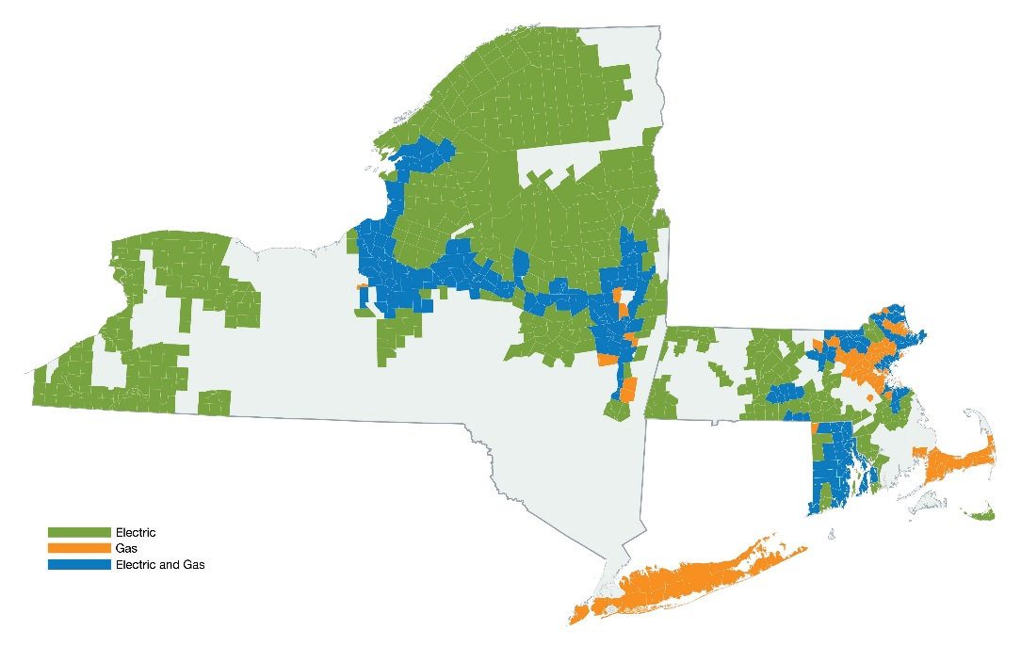
Content
GBE Customer & Metering Services (CMS) Scope
Business Data Entities Mapping to CMS Capabilities
GBE Business Data Entities Model

Slide 3
GBE Customer & Metering Service Scope

Slide 4












GBE Capability Model
Corporate Strategy
Portfolio Management
Asset Management
Operations
Customer and Services
Maximo
Strategy
& Planning
Capex Opex
Budgeting
Planning &
Evaluation
Asset Strategy
& Policy
Asset Information & Records
Maint. Strategy Formulation
Ops Efficiency
/Optimization
EH&S
Customer
Service
Meter Ops
Org Design
Regulatory
Planning
Portfolio Mgmt
& Control
Outage
Management
Monitoring
SCADA/EMS
Salesforce
Asset Investment Planning
Routine Work
Generation
New Customers
Bus
Performance
Asset Condition
& Risk
Work
Clearance
Shift Ops &
Logs
SAP
Corporate
Performance
Closeout &
Benefits
Customer Billing
& Rates
PowerPlan
Capital Investment
Planning
Capital Project Management
Work Management
Engineering and Design
Project Gov
Process
Contract
Management
Risk
Management
Work Analysis
& Reporting
Work
Initiation & Design
Quality Control
CUs Mgmt
GIS
WFS
Long-Term Capital Planning
Permits
& ROW
DnVGL
Project
Origination
Scope Mgmt
& Change
Planning
& Schedule
Mgmt
Project Org
Work Closing
Work Execution &
Data Collection
Work Planning & Estimating
Standards
Eng Planning
& Scheduling
CopperLeaf
Project
Optimization
Construction
Mgmt & Supervision
Cost Mgmt
Performance
Reporting
Work Scheduling/
Dispatch
Engineering
Quality Control
Legacy
CSS/CRIS
Corporate Support
Workforce Planning
Supply Chain
ESRI
Tax
Fixed Asset
Accounting
Finance &
Accounting
Materials
Management
Plan &
Procurement
LEMUR
Workforce
Strategy &
Alignment
Resource
Management
Capacity
Planning &
Forecasting
Financial
Analysis
HR Payroll
Time Entry
Contract & Vendor
Management
Manage Item & Service Catalog
ArcFM
Datahub
Supporting Capabilities
Customer &
Services
Finance &
Accounting
Comms &
Change Mgmt
Human
Resources
IT
Analytics/
Performance
Mgmt
Enterprise
Risk Mgmt
Analysis &
Continuous
Improvement
Quality
Assurance/
Control
IDQ
GBE impacts 9 of the 13 capabilities and 41 of the 78 sub-capabilities

Slide 5
GBE Customer & Metering Services
The functional capabilities of GBE Customer and Metering Services (formally ART1) include:
Program Capability Epics | Detailed Descriptions | Customer | Company
Customer Information Management | Customer Information Management includes customer demographic, customer contact information creation and update) | X
Account Management | Billing Account Management includes view, add and update of Billing Arrangement, Bill History, Meter Reading History, Usage History, Read Qualifier, Credit, Deposit and Collection details. | X
Customer Case Management | CRM Customer Case life cycle, queue definition, routing and status transition automation and rules. |  | X
Customer Call Intake | Process and tools to optimize CSRs' ability of identifying and searching incoming Customer inquiries, such as global or customize search, screen pop from IVR. | X
Customer Interaction Management | Customer Interactions capture, view, reporting and analysis. The interactions including inbound and outbound customer calls, SMS, email, as well as field services interactions initiated by customer and company. Additionally, provide CSR near real time of work status updates. | X | X
Outbound communications | Company initiated outbound customer reach including automated outbound calls, SMS, email, correspondence (letters, post cards, etc.) capabilities. | X | X
Establish, Stop and Transfer Service | Customer initiated Establish, Stop, and Transfer of Gas & Electric Services. | X
Gas Emergency | Company and Customer requested Gas Emergency work such as Odor, Hazard, leak monitoring, leak survey, etc. | X | X
Electric Emergency and Outage | Customer requested Electric Emergency, Outage, Voltage irregularities, etc. | X
Investigation | Company and Customer requested metering and service issue. | X | X
Collections | Company initiated Collections cut in, cut out, and collection investigation work. |  | X
Meter Specific Asset Work | Company and Customer requested Meter Change, Install and Removal work including mandated maintenance metering services. | X | X
Meter Asset Work (Non-Meter) | Company and Customer requested Change, Install, Removal and adjustment of non-meter assets such as regulator, fix factor adjustment, electric wiring. | X | X
Inspections | Company initiated Inspections work such as Inspection - Cast Iron Encroachment, Inspection Gas (Inner Tite, Inside Service - High Pressure Bare Steel, etc.), BPA, Dig Safe. | X | X
Scheduling & Dispatch | Scheduling and Dispatch Epic focus on work priority, scheduling automations, resource contingency, productivity, appointment and resource capacity setup and adjustment with close coupling of key aspects of Resource Management Epic. | X | X
Resource Management | Resource Management Epic focus on Time Worked Actuals, Shift and Vacation Bidding, Absences and Working Absences, Scheduling, and Employee Master Sync aspects of field resources. | X | X
Gas Meter Management | Gas Meter Asset Management Epic focus on Procurement, Move, Operate, Retire and Analysis of Gas Meter. |  | X

Slide 6
GBE Technical Scope
The technical scope for GBE Customer Metering Services as a single solution to manage
Customer and metering work for gas and electric business
All gas work and gas assets
Foundational CRM / Agent desktop

Slide 7
GBE Customer & Metering Service Capabilities to Business Data Entities

Slide 8
CMS Capabilities to Business Data Entities
Data and Integrations are based on the key business entities employed.
Program Capability Epics | Customer | Account (BA) | Premise | SP/MP | Meter | Work Order
Customer Information Management | X | X
Account Management |  | X
Customer Case Management | X | X | X |  |  | X
Customer Call Intake | X | X | X
Customer Interaction Management |  | X |  |  |  | X
Outbound communications | X | X |  |  |  | X
Establish, Stop and Transfer Service | X | X | X | X | X | X
Gas Emergency | X | X | X | X | X | X
Electric Emergency and Outage | X | X | X | X | X | X
Investigation | X | X | X | X | X | X
Collections | X | X | X | X | X | X
Meter Specific Asset Work | X | X | X | X | X | X
Meter Asset Work (Non-Meter) | X | X | X | X | X | X
Inspections | X | X | X | X | X | X
Scheduling & Dispatch |  |  | X | X | X | X
Resource Management |  |  |  |  |  | X
Gas Meter Management |  |  |  |  | X
APIs drive master and transactional data queries and updates to support CMS capabilities areas.
getCustomer
getBA
getPremise
getAsset
getServOrd
updCustomer
updBA
getServTerritory
maintainSrvOrd
createCustomer
getRates
createWO
getDepQuote
getHoldReason
updWO
getPgmEligibility
getCPREligibility
validateAddress & formatAddress

Slide 9
Data Model

Slide 10
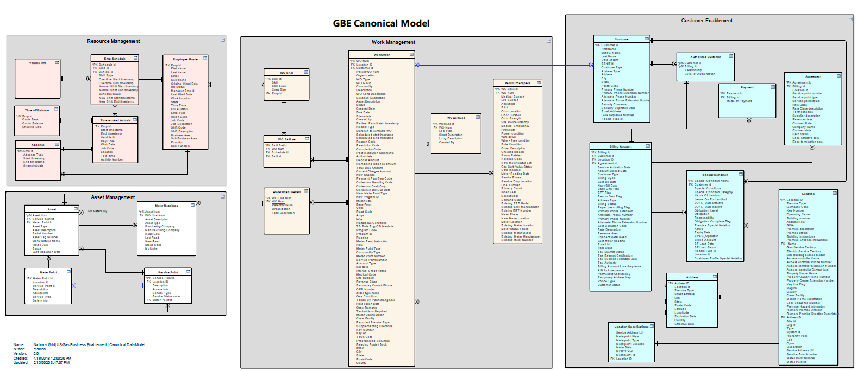
GBE Business Data Model

Slide 11
Salesforce Core Objects for Customer
Customer (Person Account)
Agreement
Contact
Account
Billing Account
Assets
Special Condition
Premise (Location)
Standard
Custom

Slide 12
Salesforce Data Model

